Slide 1
Data Models (part 3) SI649
Eytan Adar
http://si649.cond.org + CTools

Slide 2
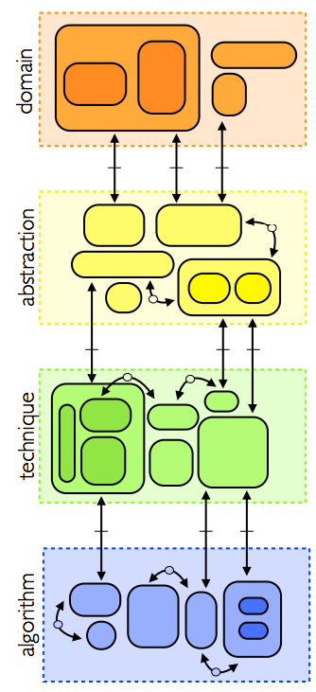
Task
Data
Count
Abstract type
(nominal, ordinal, etc.)
Physical type
(int, float, etc.)
mapping
Visual encoding
Visual metaphor
Mark/Image
Count
Visual channel
Retinal Variables
Meyer et al., 2013

Slide 3
What’s a mark?

Slide 4
What do marks represent?
Entities
“things”
person/place/company/etc.
“properties of things”
weight/population/etc.
Relationships
Is a friend, is a parent, is in the same club, is after, etc.

Slide 5
Bertin’s Semiology
Images perceived as a set of signs
Sender encodes information in signs
Receiver decodes information from signs
Encode quantitative variables
A,B, and C and distinguishable
B is between A and C
BC is twice as long as AB
+C
+B
+A

Slide 6
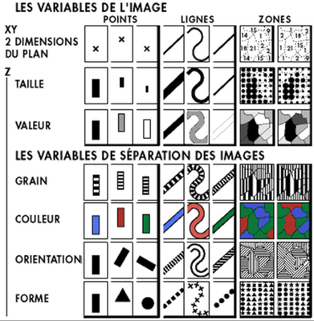
Visual Encoding Variables
Primitives
Points, lines, areas, volumes
Attributes
Visual/retinal variables

Slide 7
Visual Encoding Variables
Position (2D)
Size
Value
Texture
Color
Orientation
Shape
(Transparency, Blur, etc.)

Slide 8
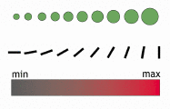


Mappings
Continuous (Q)
Ordered (O)
Categorical (N)

Slide 9
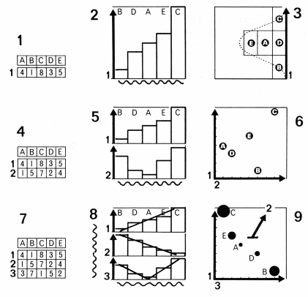
Encoding data

Slide 10
Encoding (Well Designed)

Slide 11


Bertin’s “Levels of Organization”
Position | N | O | Q
Size | N | O | Q
Value | N | O | Q
Texture | N | O
Color | N
Orientation | N
Shape | N
O:
Q:
Not as good
Adapted from Heer

Slide 12
Automated Solution
Mackinlay’s APT
Exponential number of possible encodings
Consistency:
Properties of the image (visual variables) should match the properties of the data
Importance ordering:
Encode the most important information in the most effective way

Slide 13
Criteria of algorithm
Expressiveness
A set of facts is expressible in a visualization if the visualization expresses all the facts in the set of data and only the facts in the data
Effectiveness
A visualization is more effective if the information conveyed by one visualization is more readily perceived than the information in another visualization

Slide 14
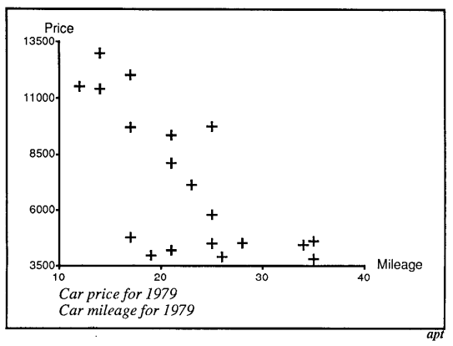
Automatic visualizations
Expresses relation between mileage and price
Does not expresses relation of specific cars

Slide 15
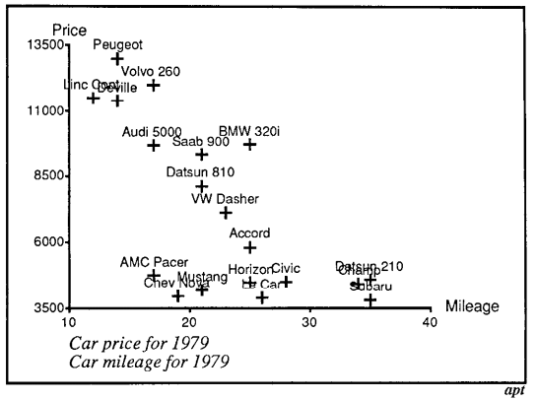
Automatic visualizations
Expresses relation between mileage and price + supports comparison of cars
Over-expresses if we don’t care about specific cars

Slide 16
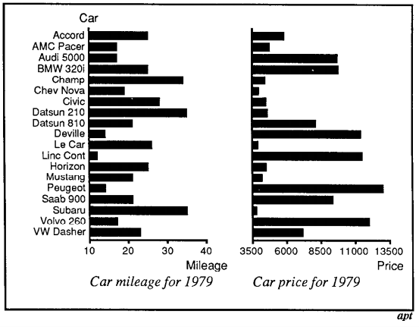
Automatic visualizations
Expressive, but not effective!

Slide 17
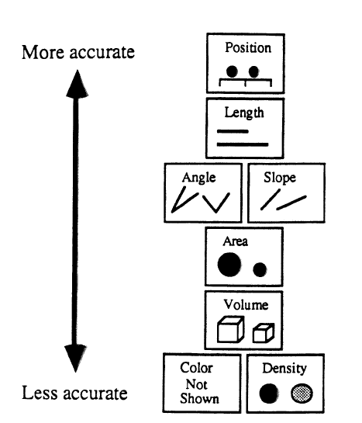
Mackinlay, Automating the Design of Graphical Presentations of Relational Information

Slide 18
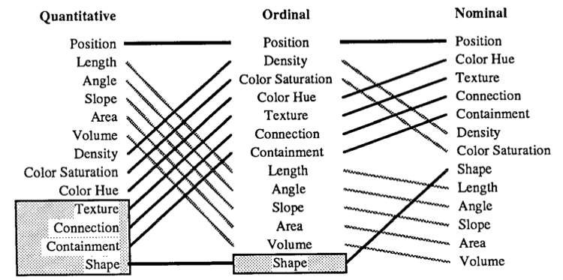
Ranking of Perceptual Tasks
Notes:
Gray = not relevant

Slide 19
Automated Solution
Mackinlay’s APT
Search the design space given input data
Limits:
Does not cover many visualization techniques
Or deal with interaction

Slide 20
Summary
Specification of data
Conceptual model
Data model
Data types and taxonomies
Data to image encodings
Design space for image encoding

Slide 21
Keys things to know about
Nominal, Ordinal, Quantitative
Which “operations” are allowed
Marks
Retinal variables
Colors, position, shape, etc.
Expressiveness
Best design choices that support the comparisons (and only those that we want to support)
Effectiveness
Best (perceptual way) to support

